Slide 1
SQL Maven Pizza Sales Analysis
Fauzia Y. Ayupuspita

Slide 2
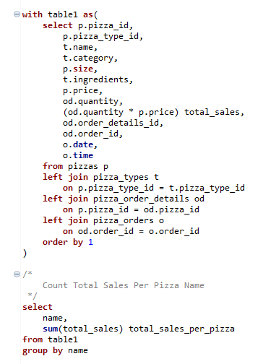
Write an SQL statement to count Total Revenue Per Pizza Name

Slide 3
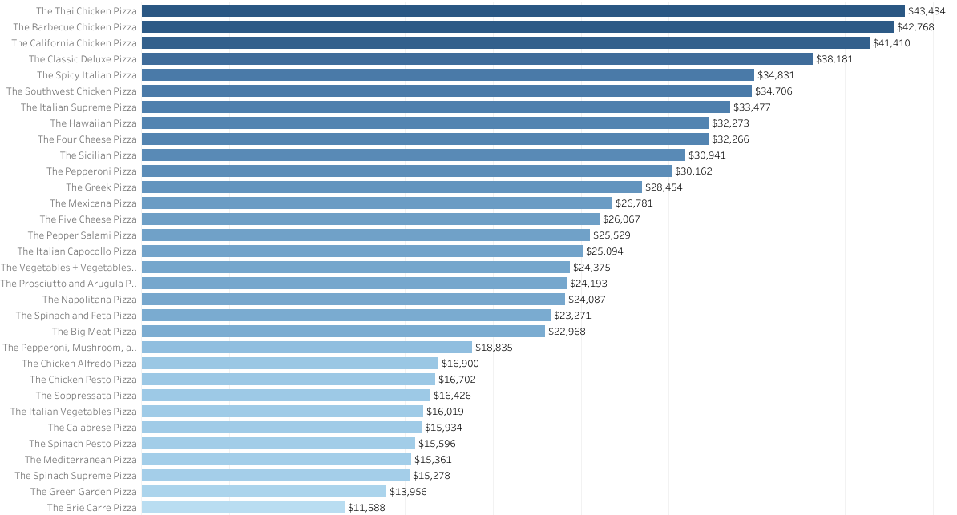
Thai Chicken Pizza Made The Most Revenue
The Thai Chicken Pizza is has the most revenue in 2015 with $43,434
Followed by The Barbeque Chicken Pizza with a difference of Thai Chicken Pizza of approximately $666

Slide 4
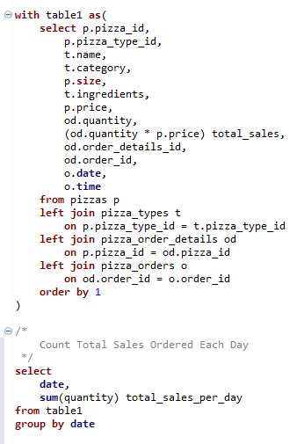
Write an SQL statement to count total sales each month

Slide 5
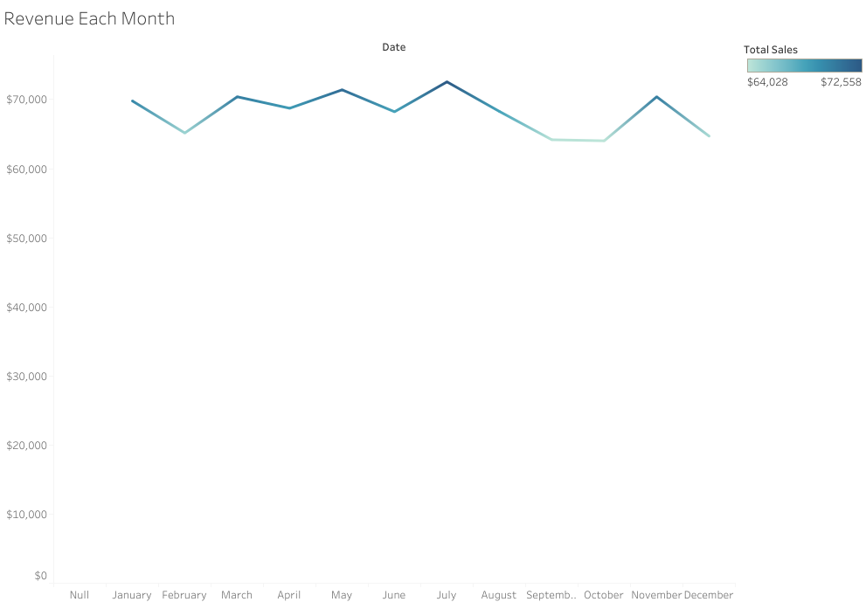
July is The Highest Sales in 2015
The difference with the other is not too far, the closest sales is May, with a difference about $2,000
The most sales in 2015 were in July, which is $73,000

Slide 6
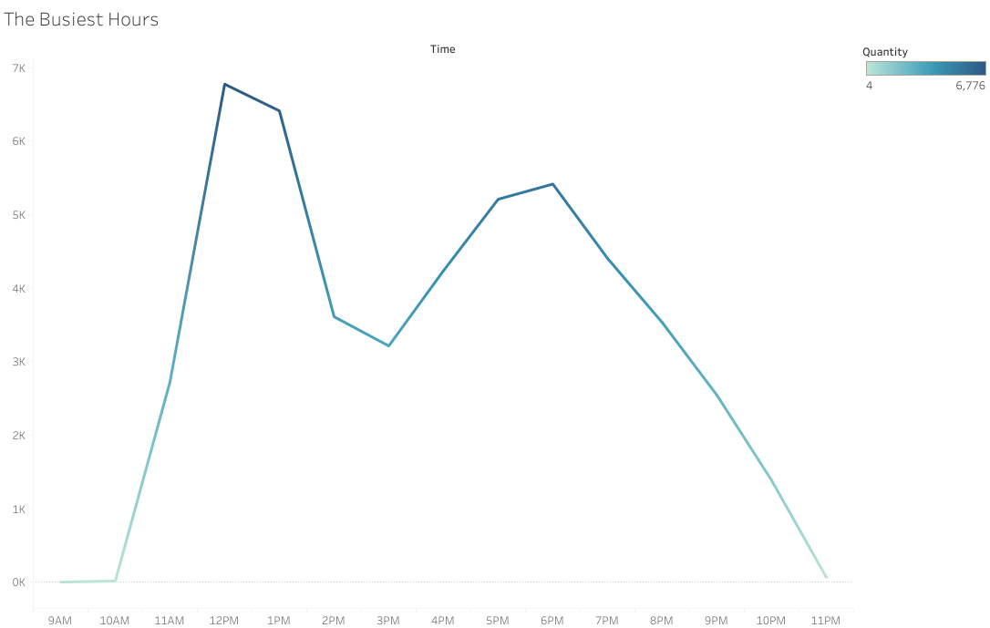
12 pm is The Busiest Hour
The busiest hour at 12 pm, which is around 5,506 orders
This happened because it’s lunch time, and time to order pizza is short

Slide 7
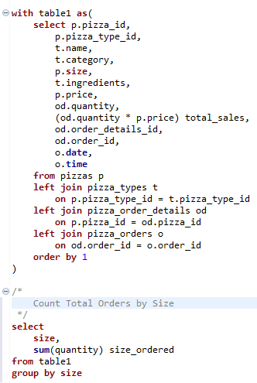
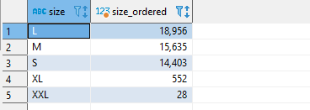
Write an SQL statement to count Total order by size

Slide 8
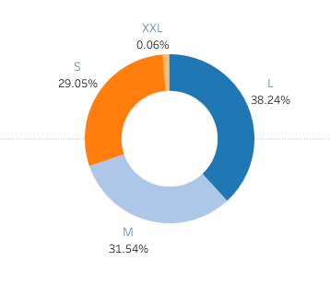
The Most Ordered Pizza is L Size
The most ordered pizza is L size with 38.24%
It can be, because the this portion is just right, not too big and not too small, so they can share with others, or if they have large portion of meal, they can finish it by their self

Slide 9
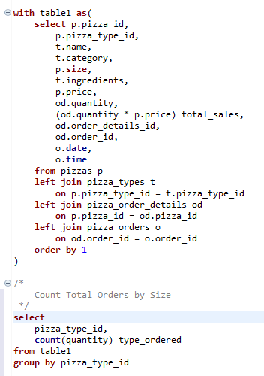
Write an SQL statement to count Total order by pizza type

Slide 10
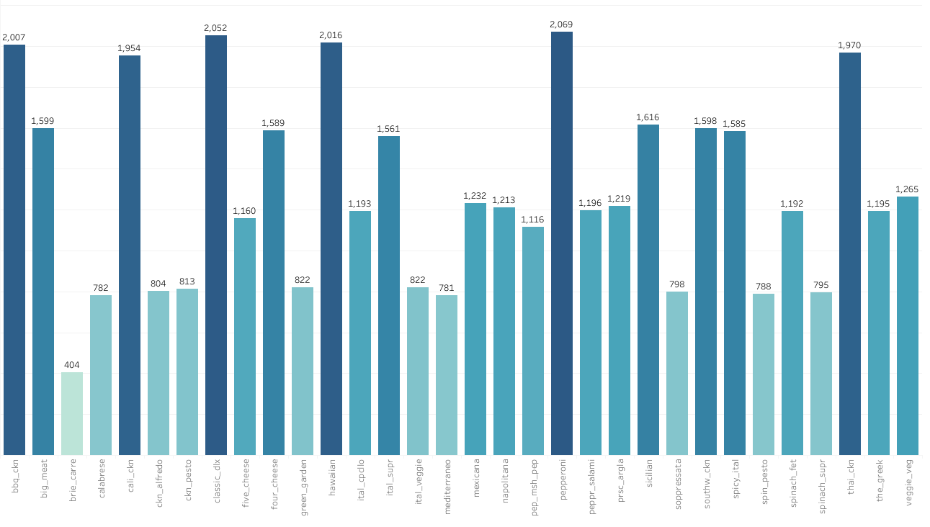
Pepperoni is The Most Ordered Pizza
The most ordered pizza type is Pepperoni with 2,065 orders
The least ordered pizza is Brie Carre pizza with 404 orders

Slide 11
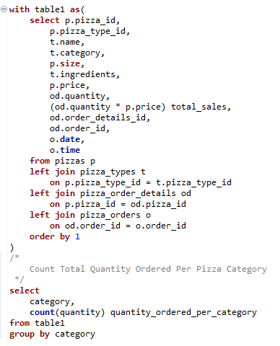
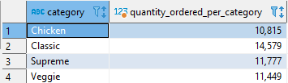
Write an SQL statement to count total order by pizza category

Slide 12
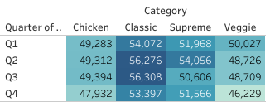
Sales by Category & Quarter
The most revenue by Pizza Category in Q2 with total revenue $208,370
Category Classis Pizza give the most revenue all the year with total revenue $220,053

Slide 13
THANK YOU

